Slide 1


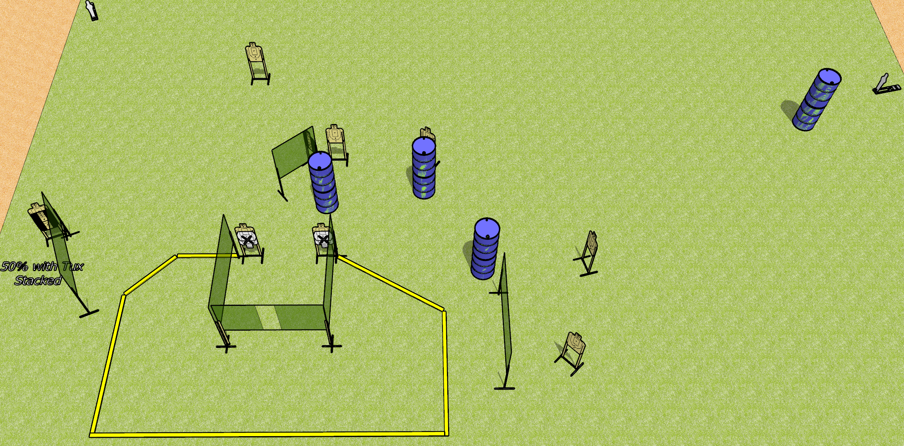
 | Dothan Gun Club – USPSA Match Vengeance Course Designer : Drew Coleman
Round Count 22 rounds 10 USPSA 2 mini poppers
Equipment List 10 wall feet 2-3 medium fault lines 2 Tuxedos, 1 50%

Slide 2
Vengeance
Written Stage Briefing
Vengeance is a 22 round, 110 point, Comstock course of fire. There are 10 USPSA targets and 2 mini poppers. The best 2 hits on paper will score, and steel must fall to score. The start signal is audible.
Handgun start position is toes touching rear fault line, facing uprange, wrists above shoulders. Handgun is loaded and holstered.
PCC start position is heels touching rear fault line, stock on belt. Carbine is loaded, safety on.
On start signal, engage targets as they become available from within the shooting area.

